Slide 1
Drill with TensorFlow 2.x
Week 10
Ph.D. Junetae, Kim
Assistant professor

Slide 2
Contents
Multiclassification
Iris classification
Understanding overfitting
Introduction to overfitting
Split the data into a training and test set

Slide 3
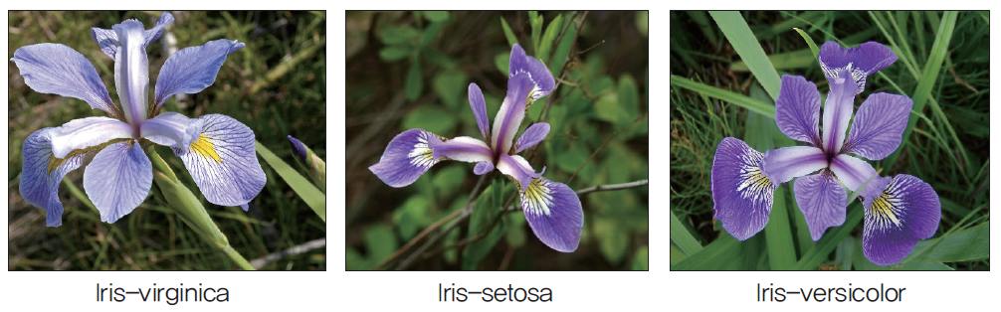
Multiclassification
Description of iris classification
Iris is divided into several species according to the shape and length of the petals.
Given similar flowers, can deep learning distinguish their species?

Slide 4
Multiclassification
Description of iris dataset
dataset/iris.csv
ID | feature1 | feature2 | feature3 | feature4 | species
1 | 5.1 | 3.5 | 4.0 | 0.2 | Iris-setosa
2 | 4.9 | 3.0 | 1.4 | 0.2 | Iris-setosa
3 | 4.7 | 3.2 | 1.3 | 0.3 | Iris-setosa
… | … | … | … | … | …
150 | 5.9 | 3.0 | 5.1 | 1.8 | Iris-virginica

Slide 5
Multiclassification
Description of iris dataset
# of obs. : 150
# of features: 4
Feature1: sepal length (cm)
Feature2: sepal width (cm)
Feature3: petal length (cm)
Feature4: petal width (cm)
Class: Iris-setosa, Iris-versicolor, Iris-virginica

Slide 6
Multiclassification
Description of multiclassification problem
More than 2 classes to predict
In other words, it is not a problem to solve with true (1) and false (0), but to predict which of several is the answer.
Multi-classification problems take a different approach than binary classification problems, where models choose one or the other.

Slide 7
Multiclassification
Descriptive analysis
How to plot a pair-plot?
How to interpret the pair-plot?
https://colab.research.google.com/github/JunetaeKim/DeepLearningClass/blob/main/Week10/IrisClassification.ipynb

Slide 8
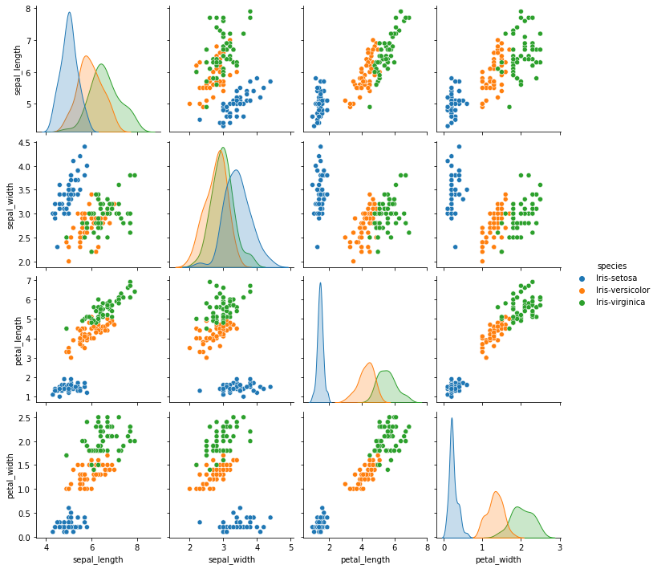
Multiclassification
Descriptive analysis

Slide 9
Multiclassification
Descriptive analysis
The size and width of the petals and sepals, which look similar in the figure, vary depending on the species
We can get a sense of the project and set up a classification strategy through a pair-plot that shows how each attribute is related.

Slide 10
Multiclassification
One-hot encoding
How to predict classes with more than 2 classes?
For this, a one-hot encoding scheme is required.

Slide 11
Multiclassification
One-hot encoding
What is one-hot encoding?
ID | species
1 | Iris-setosa
2 | Iris-versicolor
3 | Iris-setosa
4 | Iris-virginica
5 | Iris-virginica
ID | setosa | versicolor | virginica
1 | 1 | 0 | 0
2 | 0 | 1 | 0
3 | 1 | 0 | 0
4 | 0 | 0 | 1
5 | 0 | 0 | 1
one-hot encoding

Slide 12
Multiclassification
One-hot encoding
① numeric encoding
ID | species
1 | Iris-setosa
2 | Iris-versicolor
3 | Iris-setosa
4 | Iris-virginica
5 | Iris-virginica
ID | species
1 | 0
2 | 1
3 | 0
4 | 2
5 | 2
numeric encoding
LabelEncoder( )
from sklearn.preprocessing import LabelEncoder

Slide 13
Multiclassification
One-hot encoding
② one-hot encoding
ID | species
1 | 0
2 | 1
3 | 0
4 | 2
5 | 2
ID | setosa | versicolor | virginica
1 | 1 | 0 | 0
2 | 0 | 1 | 0
3 | 1 | 0 | 0
4 | 0 | 0 | 1
5 | 0 | 0 | 1
one-hot encoding
to_categorical( )
from tensorflow.keras.utils import to_categorical

Slide 14
Multiclassification
One-hot encoding
How to conduct one-hot encoding?
https://colab.research.google.com/github/JunetaeKim/DeepLearningClass/blob/main/Week10/IrisOneHot.ipynb

Slide 15
Multiclassification
How to define a multiclassification model?
Comparison between binary and multiclassification model structures
Binary classification model structure
Even if there are two classes, the target layer can be set to one dimension.
1 vs 0
Input layer
Hidden layers
Output layer

Slide 16
Multiclassification
How to define a multiclassification model?
Comparison between binary and multiclassification model structures
Binary classification model structure
ID | survival
1 | 0
2 | 1
3 | 0
4 | 1
5 | 1
1 vs 0
Input layer
Hidden layers
Output layer

Slide 17
Multiclassification
How to define a multiclassification model?
Comparison between binary and multiclassification model structures
multiclassification model structure
In the case of a multi classification model, the target layer requires as many dimensions as the number of classes.
Input layer
Hidden layers
Output layer

Slide 18
Multiclassification
How to define a multiclassification model?
Comparison between binary and multiclassification model structures
multiclassification model structure
1
ID | setosa | versicolor | virginica
1 | 1 | 0 | 0
2 | 0 | 1 | 0
3 | 1 | 0 | 0
4 | 0 | 0 | 1
5 | 0 | 0 | 1
setosa
0
versicolor
0
virginica
Input layer
Hidden layers
Output layer

Slide 19
Multiclassification
How to define a multiclassification model?
Comparison between binary and multiclassification model structures
multiclassification model structure
0
ID | setosa | versicolor | virginica
1 | 1 | 0 | 0
2 | 0 | 1 | 0
3 | 1 | 0 | 0
4 | 0 | 0 | 1
5 | 0 | 0 | 1
setosa
1
versicolor
0
virginica
Input layer
Hidden layers
Output layer

Slide 20
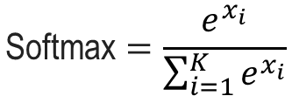
Multiclassification
How to define a multiclassification model?
Softmax function
The softmax function converts a vector of K real numbers into a probability distribution of K possible outcomes.
$$\text{Softmax}=\frac{e^{x_{i}}}{\sum_{i=1}^{K}{e^{x_{i}}}}$$

Slide 21
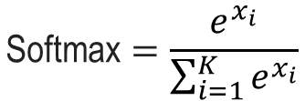
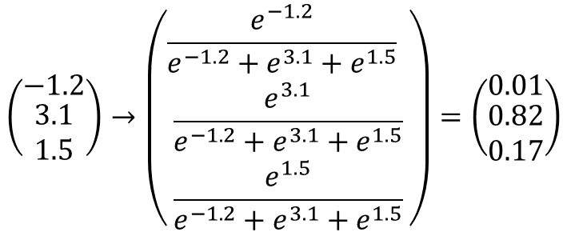
Multiclassification
How to define a multiclassification model?
Softmax function
$$\text{Softmax}=\frac{e^{x_{i}}}{\sum_{i=1}^{K}{e^{x_{i}}}}$$
$$\left(\begin{matrix}−1.2 \\ \begin{aligned}3.1 \\ 1.5\end{aligned}\end{matrix}\right)→\left(\begin{matrix}\frac{e^{−1.2}}{e^{−1.2}+e^{3.1}+e^{1.5}} \\ \begin{aligned}\frac{e^{3.1}}{e^{−1.2}+e^{3.1}+e^{1.5}} \\ \frac{e^{1.5}}{e^{−1.2}+e^{3.1}+e^{1.5}}\end{aligned}\end{matrix}\right)=\left(\begin{matrix}0.01 \\ \begin{aligned}0.82 \\ 0.17\end{aligned}\end{matrix}\right)$$

Slide 22

Multiclassification
How to define a multiclassification model?
Softmax function
The sum of values ​​converted to softmax must be 1
$$\left(\begin{matrix}−1.2 \\ \begin{aligned}3.1 \\ 1.5\end{aligned}\end{matrix}\right)→\left(\begin{matrix}\frac{e^{−1.2}}{e^{−1.2}+e^{3.1}+e^{1.5}} \\ \begin{aligned}\frac{e^{3.1}}{e^{−1.2}+e^{3.1}+e^{1.5}} \\ \frac{e^{1.5}}{e^{−1.2}+e^{3.1}+e^{1.5}}\end{aligned}\end{matrix}\right)=\left(\begin{matrix}0.01 \\ \begin{aligned}0.82 \\ 0.17\end{aligned}\end{matrix}\right)$$
$$0.01+0.82+0.17=1$$

Slide 23
Multiclassification
How to define a multiclassification model?
multiclassification model structure with tensorflow 2.x
Input
Hidden1
Hidden2
Output
relu
tanh
softmax
(None,4)
(None,5)
(None,3)
(None,3)

Slide 24
Multiclassification
How to define a multiclassification model?
multiclassification model structure with tensorflow 2.x
https://colab.research.google.com/github/JunetaeKim/DeepLearningClass/blob/main/Week10/IrisMultiClassification.ipynb

Slide 25
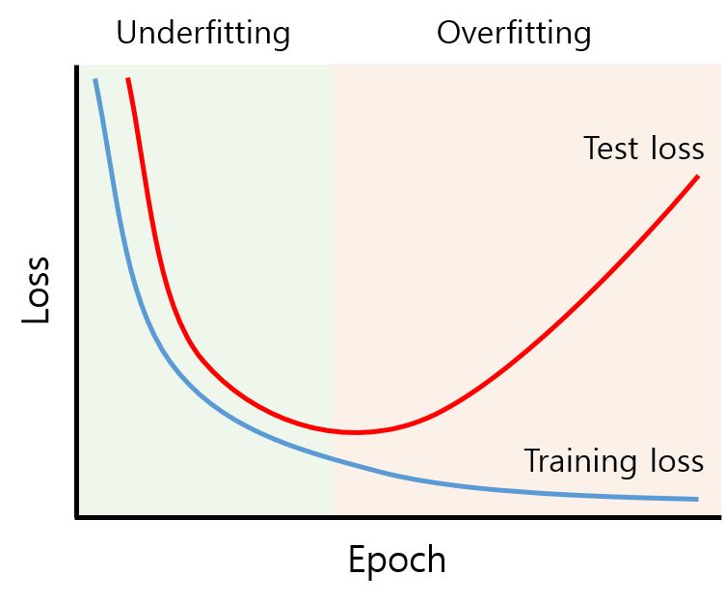
Understanding Overfitting
Overfitting
The production of an analysis that corresponds too closely or exactly to a particular set of data, and may therefore fail to fit to additional data or predict future observations reliably (wiki)
https://untitledtblog.tistory.com/158

Slide 26
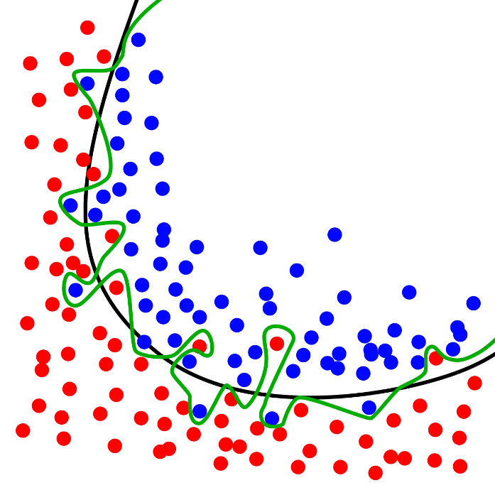
Understanding Overfitting
Overfitting
The production of an analysis that corresponds too closely or exactly to a particular set of data, and may therefore fail to fit to additional data or predict future observations reliably (wiki)
Black: excellent fit
Green: overfit
Yellow: underfit
https://en.wikipedia.org/wiki/Overfitting#/media/File:Overfitting.svg

Slide 27
Understanding Overfitting
Overfitting
The production of an analysis that corresponds too closely or exactly to a particular set of data, and may therefore fail to fit to additional data or predict future observations reliably (wiki)
https://colab.research.google.com/github/JunetaeKim/DeepLearningClass/blob/main/Week10/IntroOverfit.ipynb

Slide 28
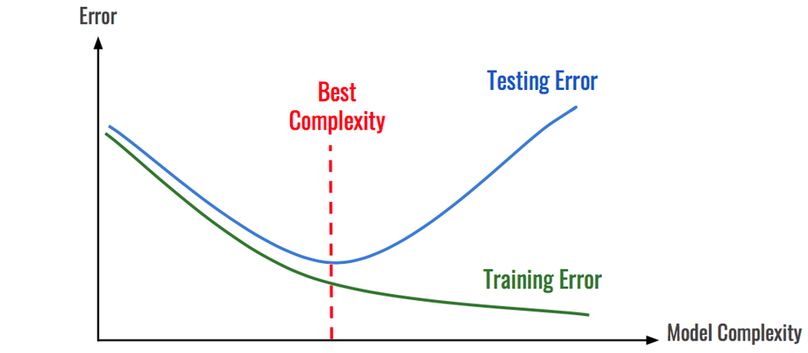
Understanding Overfitting
When does the overfitting problem occur?
When the model structure is complex.
https://image.jimcdn.com/app/cms/image/transf/dimension=1920x400:format=png/path/s8ff3310143614e07/image/i21af0dd4f2772075/version/1550368786/image.png

Slide 29
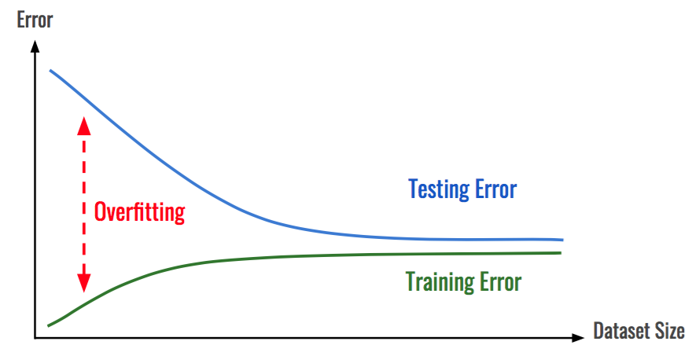
Understanding Overfitting
When does the overfitting problem occur?
When data is insufficient
https://blog.kakaocdn.net/dn/bsNLy6/btq4bBRDhgu/pt8cbOq1e9pkalI695QnTK/img.png

